Slide 1
SOEN 384
Management, Measurement and Quality Control http://users.encs.concordia.ca/~s384_2/
Lecture 3:
OO Measurement. Simple analysis techniques.
References:
Fenton, Chapter 6 – sections 6.3.1, 6.3.2, 6.3.3

Slide 2
Agenda
  Review
    Exercises
OO classical measures
Simple analysis techniques
  Boxplot
  Bar Charts
  Control Charts
Next?
soen384-F15: OOM. simple anaysis techniques

Slide 3
What is Measurement?
Measurement is the process by which numbers or symbols are assigned to things in the real world in such a way as to characterize (interpret) them according to clearly defined rules.
soen384-F15: OOM. simple anaysis techniques

Slide 4
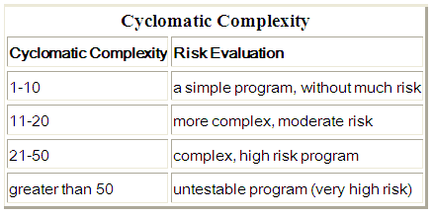
McCabe cyclomatic complexity
McCabe cyclomatic complexity (McCabe IQ tool)
Code’s
Control-Flow Graph
Number of linearly dependent paths in the code to test
Interpretation?
Acceptable?
Needs a review?
Unacceptable?
soen384-F15: OOM. simple anaysis techniques

Slide 5
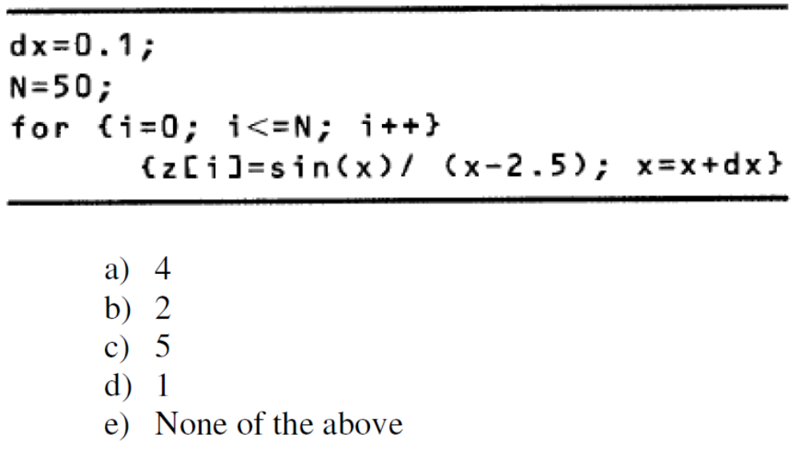
Exercise
The number of linearly independent paths of the following program segment is:
soen384-F15: OOM. simple anaysis techniques

Slide 6
Essential Complexity
Essential Complexity (McCabe IQ tool)
Code’s
Control-Flow Graph
degree of (un) structuredness
Interpretation?
Essential Complexity = 1 is excellent
EC(G1)>EC(G2) implies that G1 is more unstructured than G2
soen384-F15: OOM. simple anaysis techniques

Slide 7
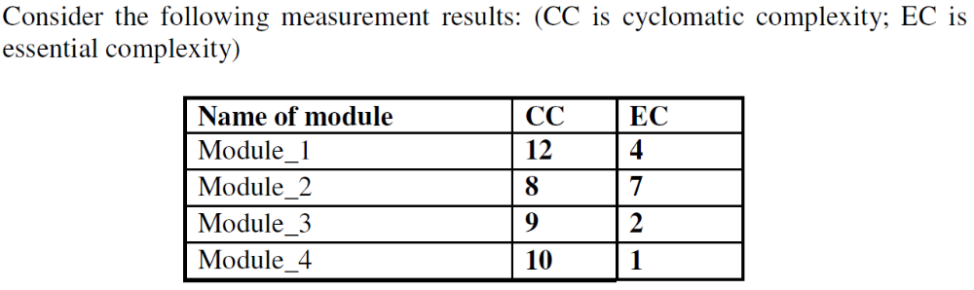
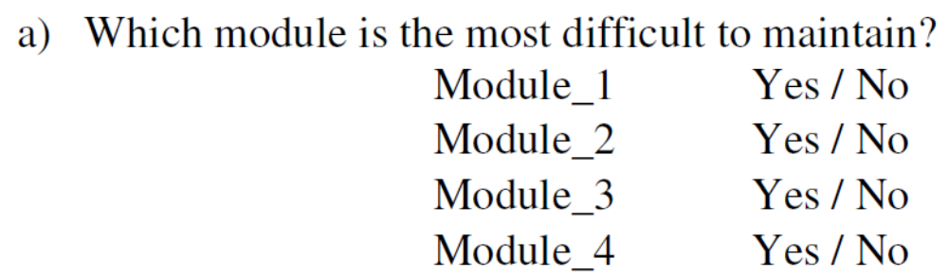
Exercise
soen384-F15: OOM. simple anaysis techniques

Slide 8
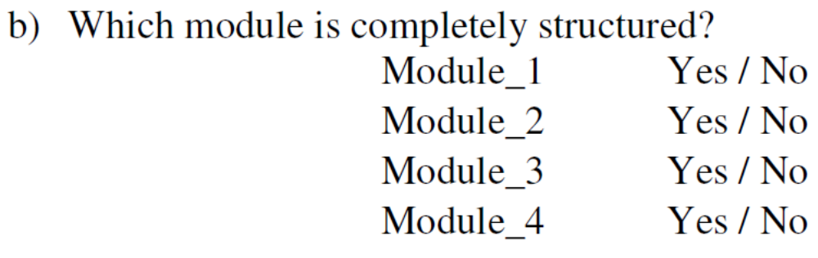
Exercise
soen384-F15: OOM. simple anaysis techniques

Slide 9
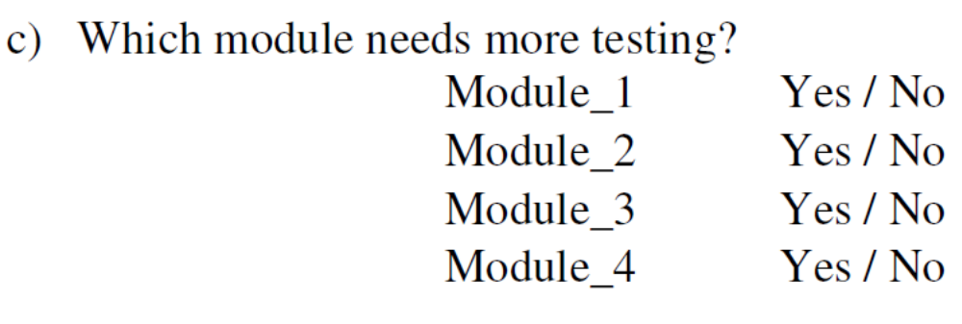
Exercise
soen384-F15: OOM. simple anaysis techniques

Slide 10
Agenda
  Review
    Exercises
OO classical measures
Simple analysis techniques
  Boxplot
  Bar Charts
  Control Charts
Next?
soen384-F15: OOM. simple anaysis techniques

Slide 11
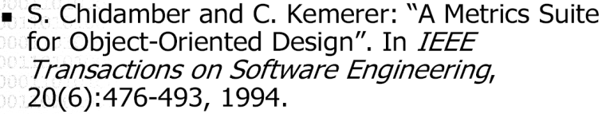
OO Classical Measures: CK

Slide 12
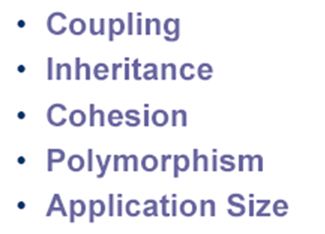
OO: what is Measurable?
Complexity of OOD depends of the measurable OO characteristics:
soen384-F15: OOM. simple anaysis techniques

Slide 13
How do we measure OO Characteristics?
Classical OO Measures (CK) by Chidamber and Kemerer:
COUPLING:
  coupling between object classes (CBO)
INHERITANCE:
  depth of the inheritance tree (DIT)
  number of children (NOC)
COHESION:
  lack of cohesion in methods (LCOM)
SIZE:
  weighted methods per class (WMC)
soen384-F15: OOM. simple anaysis techniques

Slide 14
Why Measuring Coupling is Important?
A higher degree of coupling between objects is likely to complicate application maintenance because object interconnections and interactions are more complex.
The higher the degree of object independence (i.e. the more 'uncoupled' objects are from each other) the more likely it is that objects will suitable for reuse within the same applications and within other applications.
soen384-F15: OOM. simple anaysis techniques
Notes:
Object interaction complexity associated with coupling can lead to increased error generation during development

Slide 15
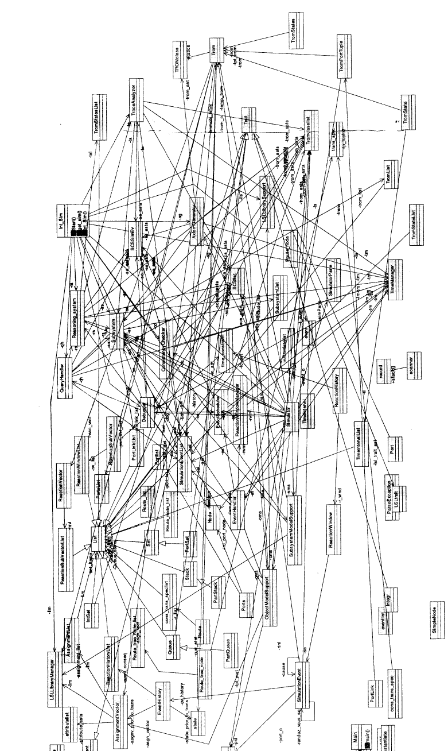
Why Measuring Coupling is Important?
soen384-F15: OOM. simple anaysis techniques
Notes:
prevents reuse

Slide 16
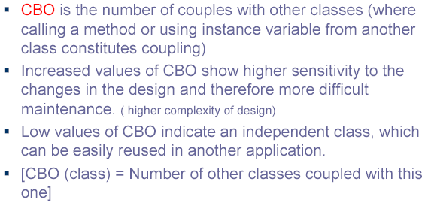
Definition and Interpretation of CBO
soen384-F15: OOM. simple anaysis techniques

Slide 17
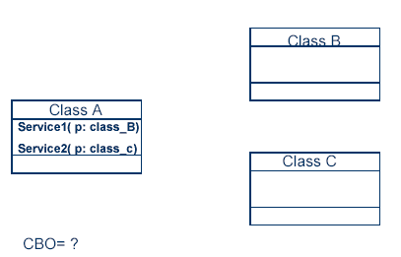
CBO Measure: Example
2
soen384-F15: OOM. simple anaysis techniques

Slide 18
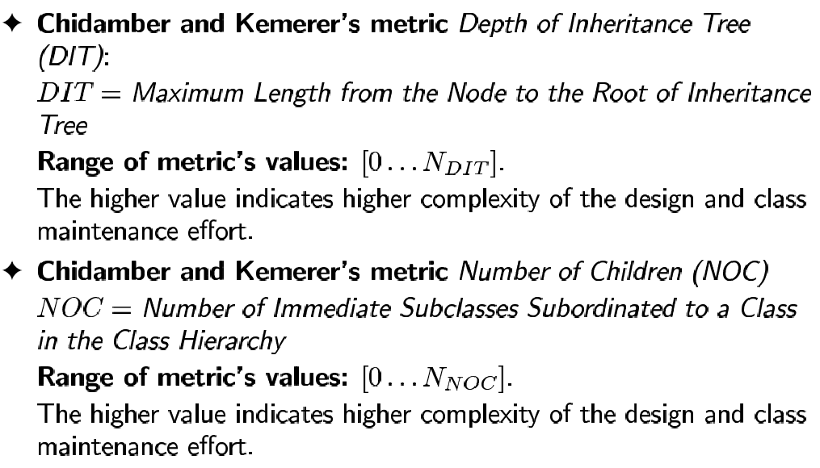
Inheritance Measurement in CK: NOC and DIT Measures
soen384-F15: OOM. simple anaysis techniques

Slide 19
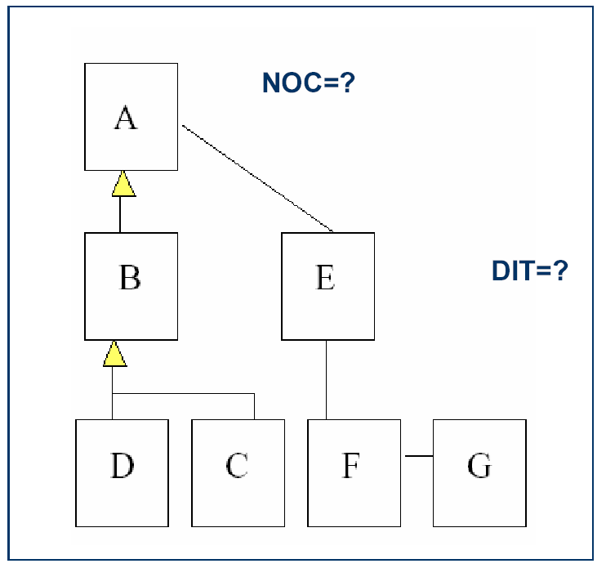
NOC and DIT Measures: Example
soen384-F15: OOM. simple anaysis techniques

Slide 20
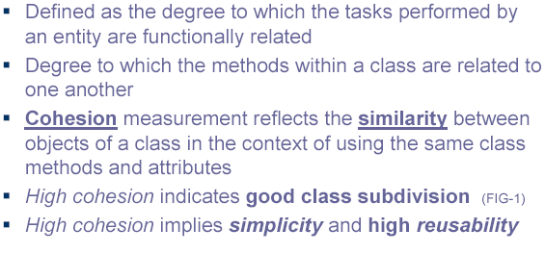
Cohesion
soen384-F15: OOM. simple anaysis techniques

Slide 21
Cohesion Measurement in CK: LCOM Measure
MOOSE: Lack of Cohesion Measure (LCOM)
LCOM measures the degree of similarity of methods by instance variable or attributes.
  - For each data field in a class, LCOM = the percentage of the methods in the class using that data field;
  the percentages are averaged then subtracted from 100%.
Classes with low cohesion could probably be subdivided into two or more subclasses with increased cohesion.
soen384-F15: OOM. simple anaysis techniques

Slide 22
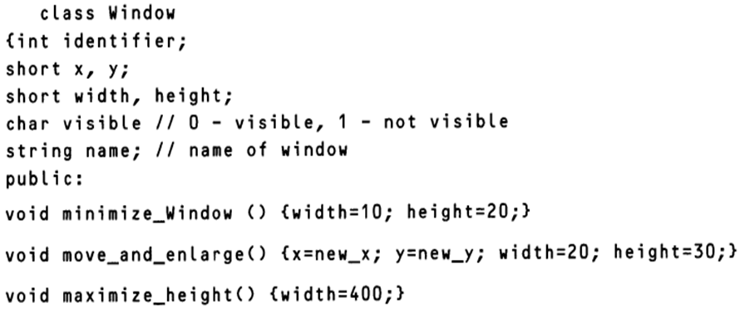
Exercise:
Determine the LCOM metric for the class concerning a window displayed in the screen:
soen384-F15: OOM. simple anaysis techniques

Slide 23
MORE ON OO MEASUREMENT IN TUTORIAL 1
(DOWNLOAD THE CODE BEFORE THE TUTORIAL)
soen384-F15: OOM. simple anaysis techniques

Slide 24
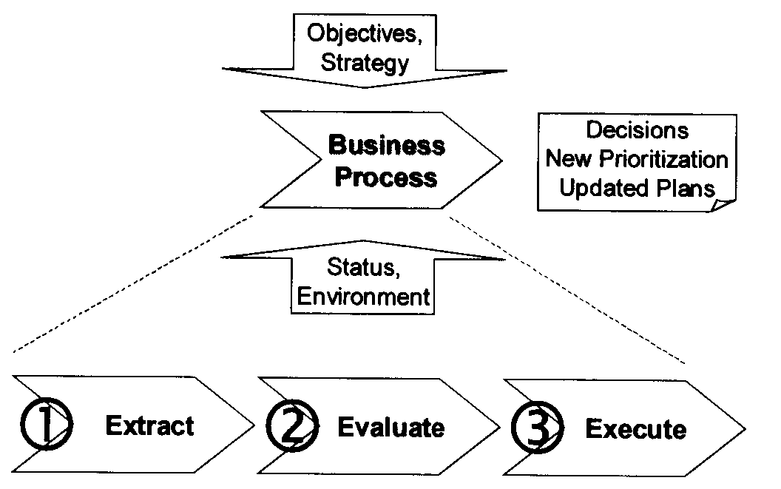
How to extract and store data
Automate data collection
Once the data is collected, we must store it in a way that supports analysis and feedback.
soen384-F15: OOM. simple anaysis techniques

Slide 25
Assignment 1
Part 1: Collect and analyze quality data with McCabe
  Quality trend
Part 2: Collect and analyze quality data with Logiscope
Source: soen390 projects
soen384-F15: OOM. simple anaysis techniques

Slide 26
How to use the data?
ClassName | CBO
junit.framework.ComparisonFailure | 1
junit.runner.BaseTestRunner | 3
junit.runner.LoadingTestCollector | 4
junit.runner.TestRunListener | 0
junit.textui.TestRunner | 6
junit.framework.TestFailure | 0
junit.runner.ClassPathTestCollector | 0
junit.framework.Test | 0
junit.framework.TestResult$InnerProtectable | 1
junit.framework.TestResult | 3
junit.framework.Protectable | 0
junit.samples.VectorTest | 3
junit.runner.TestSuiteLoader | 0
junit.framework.TestListener | 0
junit.runner.StandardTestSuiteLoader | 0
junit.framework.TestSuite$1$InnerTestCase | 2
junit.framework.TestSuite | 1
junit.runner.TestCollector | 0
junit.framework.Assert | 2
junit.runner.SimpleTestCollector | 1
junit.runner.Sorter | 0
junit.runner.Sorter$Swapper | 0
junit.framework.TestCase | 3
junit.runner.Version | 0
junit.framework.AssertionFailedError | 0
junit.textui.ResultPrinter | 3
junit.runner.FailureDetailView | 0
junit.runner.ReloadingTestSuiteLoader | 1
junit.runner.TestCaseClassLoader | 0
soen384-F15: OOM. simple anaysis techniques

Slide 27
Agenda
  Review
    Exercises
OO classical measures
Simple analysis techniques
  Boxplot
  Bar Charts
  Control Charts
Next?
soen384-F15: OOM. simple anaysis techniques

Slide 28
Box Plot
Data Analysis Question: what is the range of acceptable values for the measure?
Technique: robust (summary) statistics can be presented in a visual form called a “box plot”
    Box plot – a summary of the range of a set of data about one variable (where most of the data are clustered, outlier data)
soen384-F15: OOM. simple anaysis techniques
Notes:
Cyclomatic complexity is on the ratio scale

Slide 29
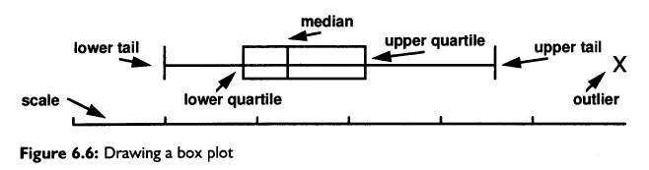
Box-Plot Statistics: appropriate from the ordinal scale type
soen384-F15: OOM. simple anaysis techniques

Slide 30
Box Plot Example
Collected data: set of attribute values (say, LOC) obtained from a set of related items (classes):
  2,4,8,5,4,11,5,11,8,10,15,11,16
  Step 1: Order (increasing):
  2,4,4,5,5,8,8,10,11,11,11,15,16
  Step 2: Find the Median
  the value that divides the data set in half (i.e., the 7th value –>8)
  Step 3: Lower and Upper Quartiles (Fourths): values that together with the median split the data set into quarters ( 5 and 11, respectively)
soen384-F15: OOM. simple anaysis techniques
Notes:
When there is an odd number of numbers, the median is simply the middle number. For example, the median of 2, 4, and 7 is 4.
When there is an even number of numbers, the median is the mean of the two middle numbers. Thus, the median of the numbers 2, 4, 7, 12 is (4+7)/2 = 5.5.

Slide 31
2,2,4,5,5,8,8,10,11,11,11,15,16
Lower and Upper Quartiles (Fourths)?
RE: “Statistics for Engineering and the Sciences”, W. Mendenhall et al.
LQ(lower forth) : calculate the quantity
  LQ=1/4 *(n+1) and round to the nearest integer; the measure with this rank represents the lower quartile.
  round(¼ * 14) ->4 pos. => LQ= 5
UQ(upper forth) : calculate the quantity
  UQ=3/4 * (n+1) and round to the nearest integer; the measure with this rank represents the upper quartile.
    round(3/4 * 14) ->11 pos. => UQ = 11
soen384-F15: OOM. simple anaysis techniques
Notes:
where n=number of elements in the sample

Slide 32
Step 4: calculate the Box Length:
  the ‘distance’ between the lower to upper fourth
  (11-5=6)
Step 5: calculate Upper and Lower Tails:
  multiplying the box length by 1.5 (6x1.5=9)
  adding and subtracting 9 from the upper and lower fourths
  {11+9=20 and 5-9 -> 0 respectively}.
  Here, lower tail is truncated at zero because a negative number of paths is not meaningful.
soen384-F15: OOM. simple anaysis techniques

Slide 33
  Data: 2,4,8,5,4,11,5,11,8,10,15,11,16
  Acceptable Range: [Lower forth, Upper forth]
    Example: values in the range [5..11] (5,5,8,8,10,11,11,11)
  quick review of the components with values in
  [lower tail .. lower forth[ U ]upper forth .. upper tail]
    Example: values in [0..5[ U ]11..20] (2,4,4,15,16)
  More stringent review of components that are statistical outliers with values greater than the upper tail or less than the lower tail
    Example: >20 (none)
soen384-F15: OOM. simple anaysis techniques

Slide 34
Goal of box-plot: to interpret data
Box plots point us to abnormal or unusual behavior.
On the other hand, they can also help us to see what is usual or normal.
Range of acceptable values: which entities are acceptable?
Range of quick review values: which entities should be reviewed?
Identify statistical outliers: which entities are unacceptable?
soen384-F15: OOM. simple anaysis techniques
Notes:
Box plots are simple to compute and draw, and they provide a useful picture of how
the data are distributed. The outliers are especially important when you are looking
for abnormal behaviors.

Slide 35
Exercise: Apply boxplot technique to CBO data.
Outliers?
ClassName | CBO
junit.framework.ComparisonFailure | 1
junit.runner.BaseTestRunner | 3
junit.runner.LoadingTestCollector | 4
junit.runner.TestRunListener | 0
junit.textui.TestRunner | 6
junit.framework.TestFailure | 0
junit.runner.ClassPathTestCollector | 0
junit.framework.Test | 0
junit.framework.TestResult$InnerProtectable | 1
junit.framework.TestResult | 3
junit.framework.Protectable | 0
junit.samples.VectorTest | 3
junit.runner.TestSuiteLoader | 0
junit.framework.TestListener | 0
junit.runner.StandardTestSuiteLoader | 0
junit.framework.TestSuite$1$InnerTestCase | 2
junit.framework.TestSuite | 1
junit.runner.TestCollector | 0
junit.framework.Assert | 2
junit.runner.SimpleTestCollector | 1
junit.runner.Sorter | 0
junit.runner.Sorter$Swapper | 0
junit.framework.TestCase | 3
junit.runner.Version | 0
junit.framework.AssertionFailedError | 0
junit.textui.ResultPrinter | 3
junit.runner.FailureDetailView | 0
junit.runner.ReloadingTestSuiteLoader | 1
junit.runner.TestCaseClassLoader | 0
soen384-F15: OOM. simple anaysis techniques

Slide 36
Utility of Box-plots
providing norms for planning purposes
summarizing actual measurements for the purposes of project monitoring
identifying software items with unusual values for quality control and process evaluation.
soen384-F15: OOM. simple anaysis techniques

Slide 37
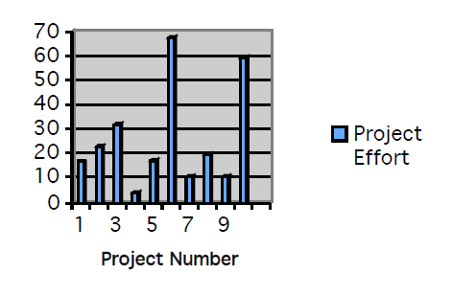
Bar Chart
displays all the data ordered to see what the patterns or trends may be.
soen384-F15: OOM. simple anaysis techniques
Notes:
We can see from the bar chart that most of the projects require less than 40 personmonths
of effort, but two require a great deal more. Such information raises many
questions, and often we want to know the relationship between one attribute (such as
effort in this example) and others (such as size). Unlike box plots, bar charts allow us
to readily identify the entity associated with each measured value.

Slide 38
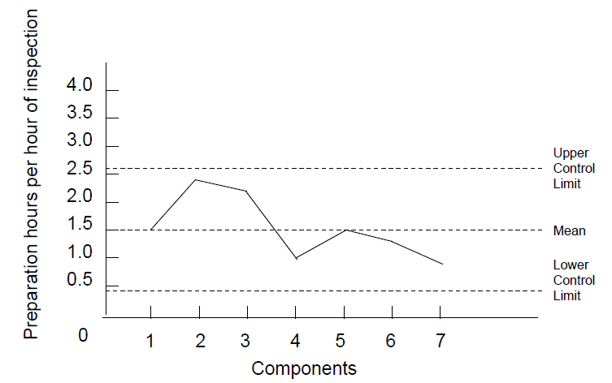
Control Charts:
control chart graph shows the upper control limit, the mean, and the lower control limit
The control limits act as guidelines for understanding when the data are within random statistical variation and when they represent unusual behavior
soen384-F15: OOM. simple anaysis techniques
Notes:
We calculate
the mean and standard deviation of the data, and then two control limits. The upper
control limit is equal to two standard deviations above the mean, while the lower
control limit is two standard deviations below the mean (or zero, if a negative control
limit is meaningless).

Slide 39
Homework 2
Practice the simple data analysis techniques seen in this class on the data collected in Homework 1
soen384-F15: OOM. simple anaysis techniques

Slide 40
Next?
POD sessions: Wednesdays 16:00 -- 19:00 (H845) (Zhu Ming)
Lecture 4: Goal-based software measurement (Goal-Question-Metric GQM).
Homework 2 on Boxplot analysis
soen384-F15: OOM. simple anaysis techniques

Slide 41
Questions?
…
soen384-F15: OOM. simple anaysis techniques

